Slide 1
GLRI Ecological Focus Workgroup Members
GLRI – Ecological Focus John Hull Dr. Val Klump Kay Nelson Steve Galarneau

Slide 2
GLRI – ecological focus workgroup
GLRI Related Charge Questions: 3, 5 & 6
Theme 3: Seek Advice and Recommendation on GLRI Outreach
Theme 5: Outcome Based Investments in the Great Lakes
Theme 6: GLRI’s Role in the Vitality and Reinvestment of Great Lakes Communities

Slide 3
Charge Question 5
As we enter the next decade of GLRI funding, what are appropriate annual ecological and community-based outcomes (coupled with appropriate baselines and monitoring) to show that we are making progress in the areas of AOC remediation and delisting, invasive species control and prevention, nutrient reduction, and habitat restoration and protection, such that we can show a good return on investment?

Slide 4
Charge Question 6
How can GLRI projects and funding be further leveraged across Federal agencies and programs, including Opportunity Zones and Brownfields, to maximize environmental and economic benefits to Great Lakes communities?

Slide 5
GLRI Ecological Focus Workgroup Charge Questions 5, & 6
C5 - Annual Ecological outcomes
Baseline data
Metrics / Monitoring data
Return on Investment
C6 – GLRI Leveraging across Federal Agencies and Programs
Maximize Environmental and Economic benefits to Communities

Slide 6
Charge Question 3
How well are EPA and its federal, state and tribal partners communicating the goals, challenges and accomplishments of GLRI? Are there stakeholder groups that could be more effectively communicated with? What additional and/or innovative tools could be used to improve outreach to citizens, elected officials and partners?

Slide 7
GLRI Ecological Focus Workgroup Charge Question 3
C3 - Communication
Goals
Who are we missing?
Stakeholders' communication
Challenges
Accomplishments of GLRI
How do we communicate better?
Improve outreach
Financial & technical support leveraging existing resources e.g. libraries

Slide 8
Recommendations
We recommend that the GLRI be recognized that is not just restoration, but also a protection and management program – requiring a sustained commitment.
Engage State and Tribal partners actively in the selection and funding of projects.
Base projects on local priority areas. Not just a single subject or topic area.
Assure close alignment of all Federal agencies that are part of the Federal Working Group with State and Tribal priorities.
Evaluate GLNPO staffing needs and adjust commensurate with implementing the GLRI program.
Leverage work by each member agency by communicating project proposals, implementation and reports with other agencies, states and tribes, science community, and public for full use.

Slide 9
Recommendations
We recommend that the GLRI include a focus on restoring and protecting ecosystem services.
account for the value of greenspaces, safe public access to waterways, and generally greater community interaction with natural systems.
We recommend engaging environmental economists to establish baseline data needs, ecosystem services metrics, evaluation and milestones.

Slide 10
Recommendations
We recommend providing management assistance funding to States and Tribes to hire boots-on-the-ground staff with technical expertise and skills in social sciences and community engagement.
Augment local accessible communication technology resources through grants
We recommend leveraging GLRI for sustained:
employment opportunities through education in local communities
investments by GLRI through support of long-term Operation and Maintenance (O&M) for projects.

Slide 11
Recommendations
We recommend mapping Brownfield sites, Opportunity Zones and other agency and community programs with GLRI project proposals to maximize awareness and leveraging opportunities.
We recommend greater engagement with business and industry to leverage their sustainability plans and vision with GLRI ecological services.
Evaluate the nexus between Food, Energy, Water and Transportation.

Slide 12
Recommendations
We recommend establishing a Cabinet Level position for Water as we do for Energy.
Water quantity and quality - a national interest
Climate resilience and sustainability
Funding of Research and Development for early understanding of emerging challenges

Slide 13
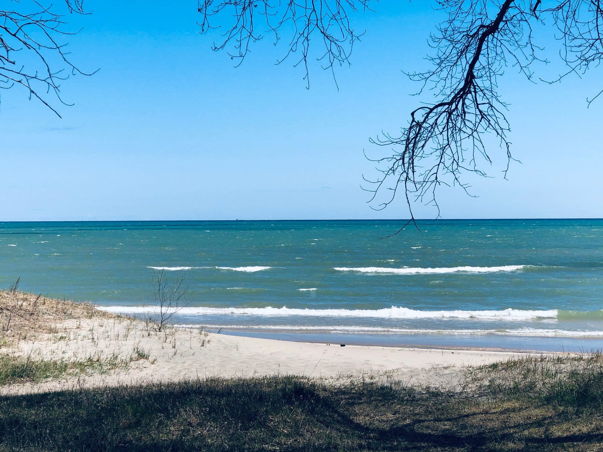
Discussion

